Slide 1
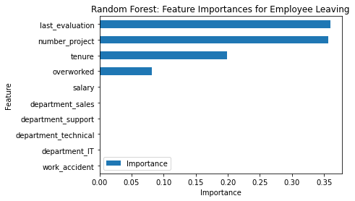
Salifort Motors
Employee Retention Project
Project Overview
Salifort Motors aims to create a supportive work culture where employees are hoisted toward professional success and development. However, the leadership team have raised concerns regarding the high turnover rate among employees. Our goal is to assist them in determining what factors may lead them to leave the company.
Last evaluation, number of projects, tenure and whether are overworked or not are the best predictors of employee retention.
There does not seem to be a correlation between any departments and employee departures.
Employees who work longer hours should be rewarded with promotions. If passed over, they are more likely to resign.
Employees who work over 175 hours a month should be exempt from getting low scores on their evaluation.
If not rewarded or recognized overworked employees are more likely to be burnt out and/or think of departing the company.
The number of projects should be more evenly spread among employees to reduce pressure and workload on longer tenured employees.
In the Random Forest model above, ‘last_evaluation’, ‘number_project’, ‘tenure’, and ‘overworked’ seem to be the features with the highest importance in predicting employee turnover.
- Evaluations may need to be performed more regularly and on a proportionate scale with regards to hours worked and/or number of projects.
- There were some concerns of data leakage during this project which resulted in satisfaction level being dropped as a feature.
- In a future project, a clustering model could be used to compare the impact of satisfaction levels, evaluation performance, and average monthly hours worked.

